Slide 1
AUTONOMIC NEUROPATHY IN DIABETES MELLITUS: ANESTHETIC IMPLICATIONS
Dr. Aruna Parameswari
Professor and Head
Department of Anesthesiology and Pain Medicine
Sri Ramachandra Institute of Higher Education and Research
Chennai

Slide 2
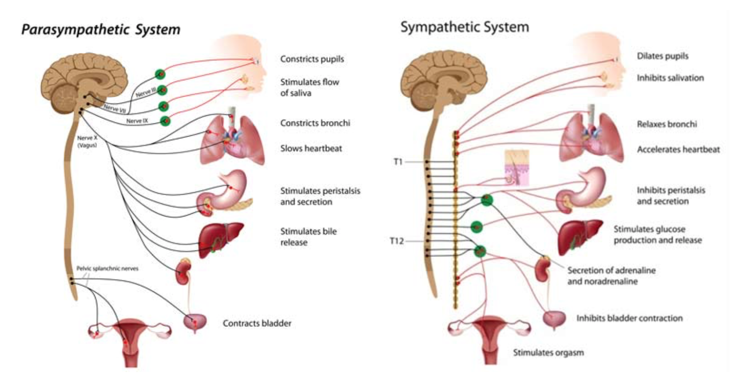
Introduction
Part of the nervous system that regulates involuntary functions
Heartbeat
Digestive functions of the intestines
Control of respiration
Secretion by glands
Rest and Digest
Fight and Flight

Slide 3
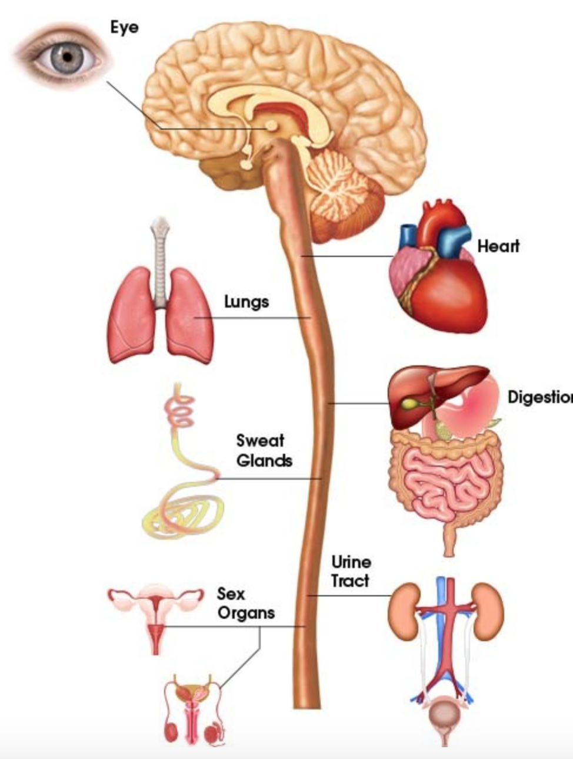
Diabetic autonomic neuropathy
Diabetes
Intracellular hyperglycemia and oxygen free radicals cause endothelial damage and destruction of nerves
Early – Parasympathetic
Late - Sympathetic
Affects various organs
Damage to the autonomic nerves

Slide 4
Organ systems affected

Slide 5
Cardiovascular
Heart rate control
Peripheral and vascular dynamics
Systolic and diastolic function
Silent MI
Arrhythmias
Orthostatic hypotension
Increased sensitivity to $α \text{and} β \text{agonists}$
Resting tachycardia
Decreased HRV
QTc prolongation
Fixed heart rate
Notes:
Fatigue, weakness, dizziness, syncope, due to denervation hypersensitivity due to sympathetic nerve degeneration

Slide 6
Other systems
Anemia
Sudomotor dysfunction
Hypoglycemia unawareness
Heartburn
Gastroparesis
Decreased ventilatory drive
Sleep apnea
Neurogenic bladder
Decreased bone density
Diarrhoea
Fecal incontinence
Notes:
Impaired Detrusor functioning, and impaired bladder sensation, incomplete emptying increased postvoid residual urine, urinary retention, infection.
Anhidrosis, gustatory sweating, vasodil, AV shunting, edema

Slide 7
Assessment
Notes:
Battery of tests rather than a single test, Both PS and S functions should be assessed.

Slide 8
Assessment - Parasympathetic
Normally heart rate increases with inspiration and decreases with expiration
Patient breathes at 6 breaths/min, Ratio of longest RR interval at expiration to shortest interval at inspiration
HR response to breathing
E/I ratio
R-R
R-R
> 15 beats
E/I > 1.17
Inspiration
Expiration
Notes:
< 10 beats and < 1.17

Slide 9
Assessment - Parasympathetic
With standing, heart rate increases as reflex response to fall in BP due to decreased venous return, then stabilizes
Ratio of R-R interval at the 30th beat to 15th beat is taken
HR response to standing
30:15 ratio
R-R
R-R
30:15 ratio > 1.04
15th beat
30th beat

Slide 10
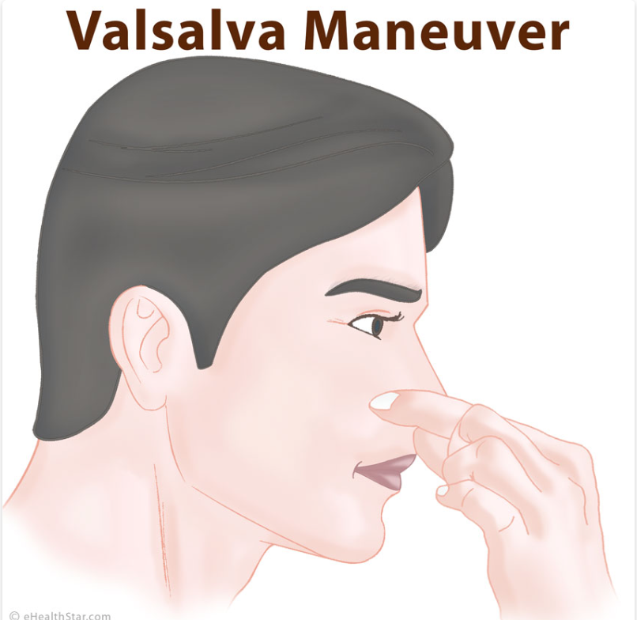
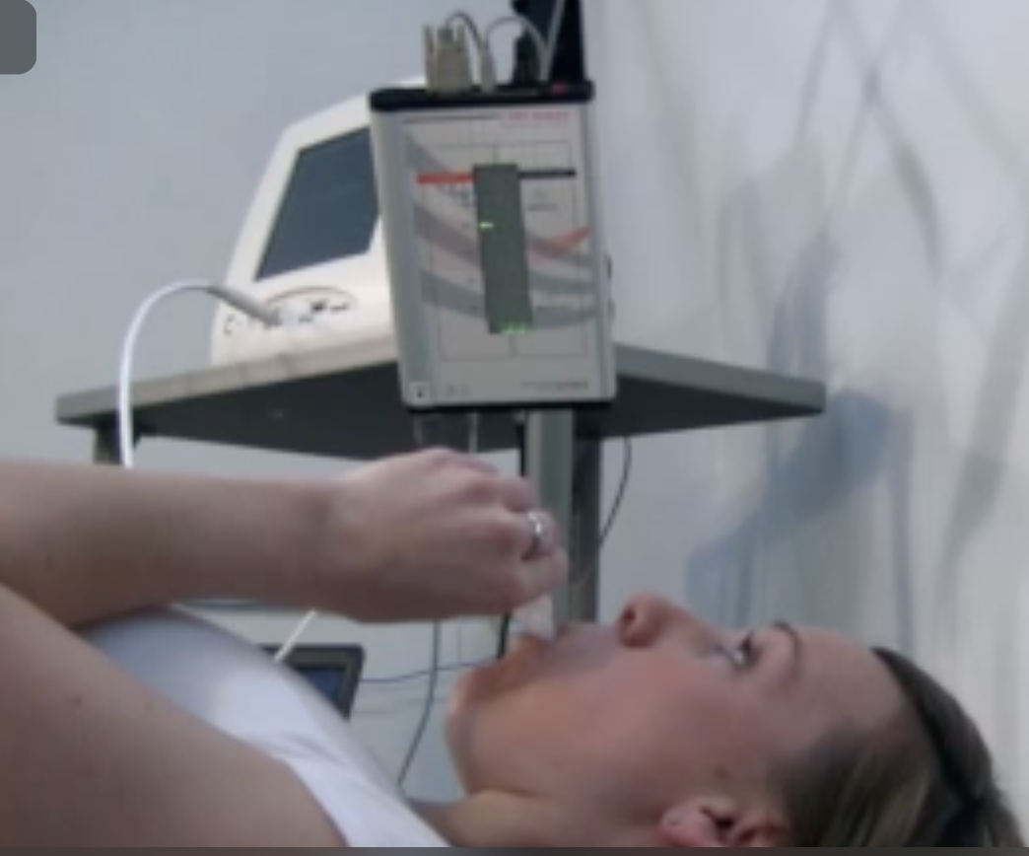
Assessment – Parasympathetic
Valsalva maneuver
Ratio of longest RR interval after strain to shortest RR interval during the strain > 1.21
Strain
Release of Strain
Valsalva
(10 sec)
Mean Aortic Pressure
Phase
I
II
III
IV
Heart
Rate
Subject blows through a closed mouth piece to maintain a pressure of 40 mm Hg for 15 seconds
Time
External compression on aorta is removed due to fall in intrathoracic pressure
Decreased venous return due to increased intrathoracic pressure
Expiration against a closed glottis
Increase intrathoracic pressure
Resumption of normal venous return and increase in cardiac output
Compression of heart and thoracic blood vessels by raised intrathoracic pressure

Slide 11
Assessment - Sym
Schellong test
SBP response to standing
From supine to standing, 2 min later, check SBP
Normal fall < 10mmHg, > 30mmHg systolic AN
DBP response to handgrip
Sustained hand grip should increase DBP by > 16 mm Hg
Cold pressor response
Immersion of hand in 4deg C cold water for 60 – 90s leads to DBP rise > 15 mm Hg
Notes:
Symptoms like dizziness, visual impairment, syncope

Slide 12
Ewing’s battery of tests
HRDB
30:15
Valsalva Ratio
BP to standing
BP handgrip
Tests of sudomotor function
Dynamic pupillometry
Other tests

Slide 13
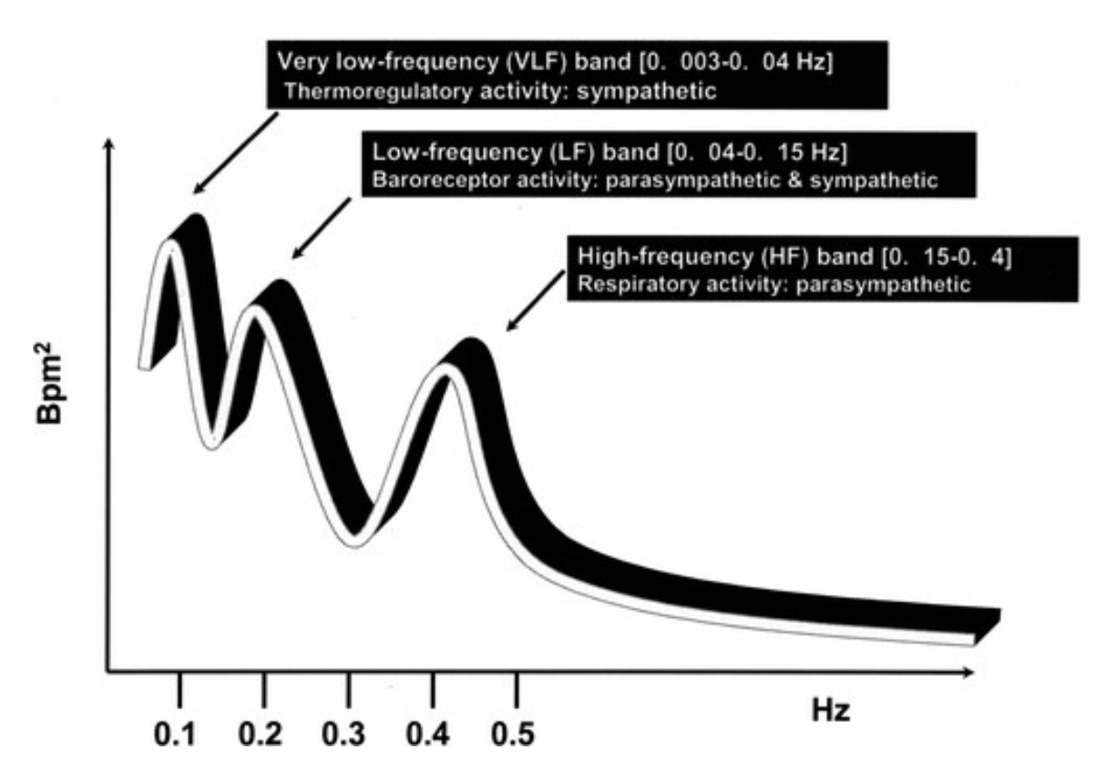
Spectral analysis for HRV
Notes:
Spectral analysis involves decomposing the series of sequential R-R intervals into a sum of sinusoidal functions of different amplitudes and frequencies using mathematical approaches, like the fast Fourier transformation or autoregressive models.

Slide 14
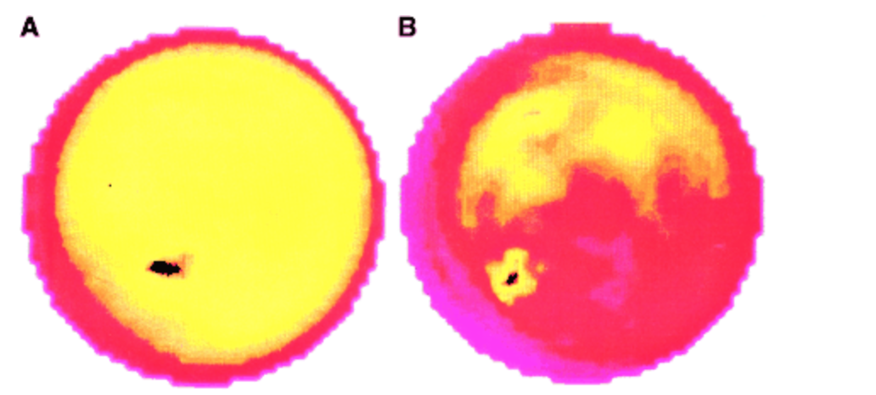
Radionuclide imaging
Cardiac mapping with MIBG
Normal sympathetic innervation
Diabetic sympathetic dysfunction
(Decreased posterior/inferior uptake)
Notes:
Metaiodobenzyl guanidine. Decreased uptake with sympathetic denervation

Slide 15
Anesthetic implications

Slide 16
Anesthetic implications
Pre
operative
Intra
operative
Post
operative
Correct anemia
Adequate NPO and Metoclopramide to prevent aspiration

Slide 17
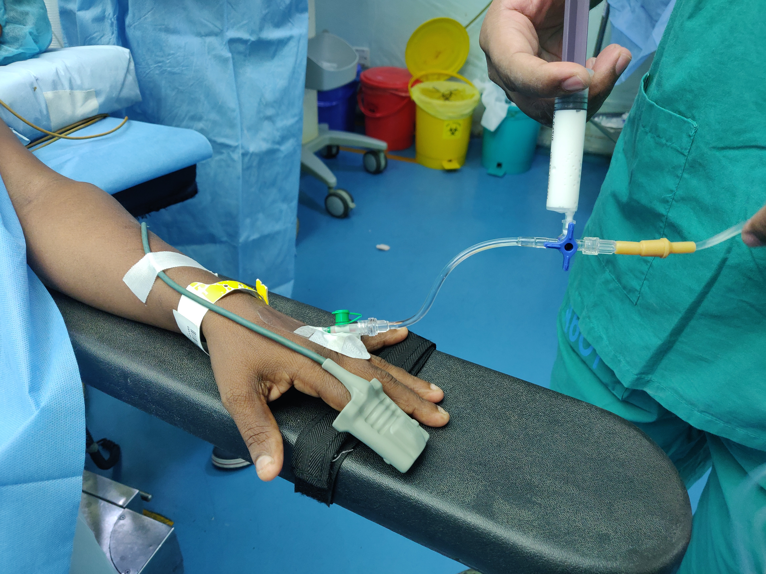
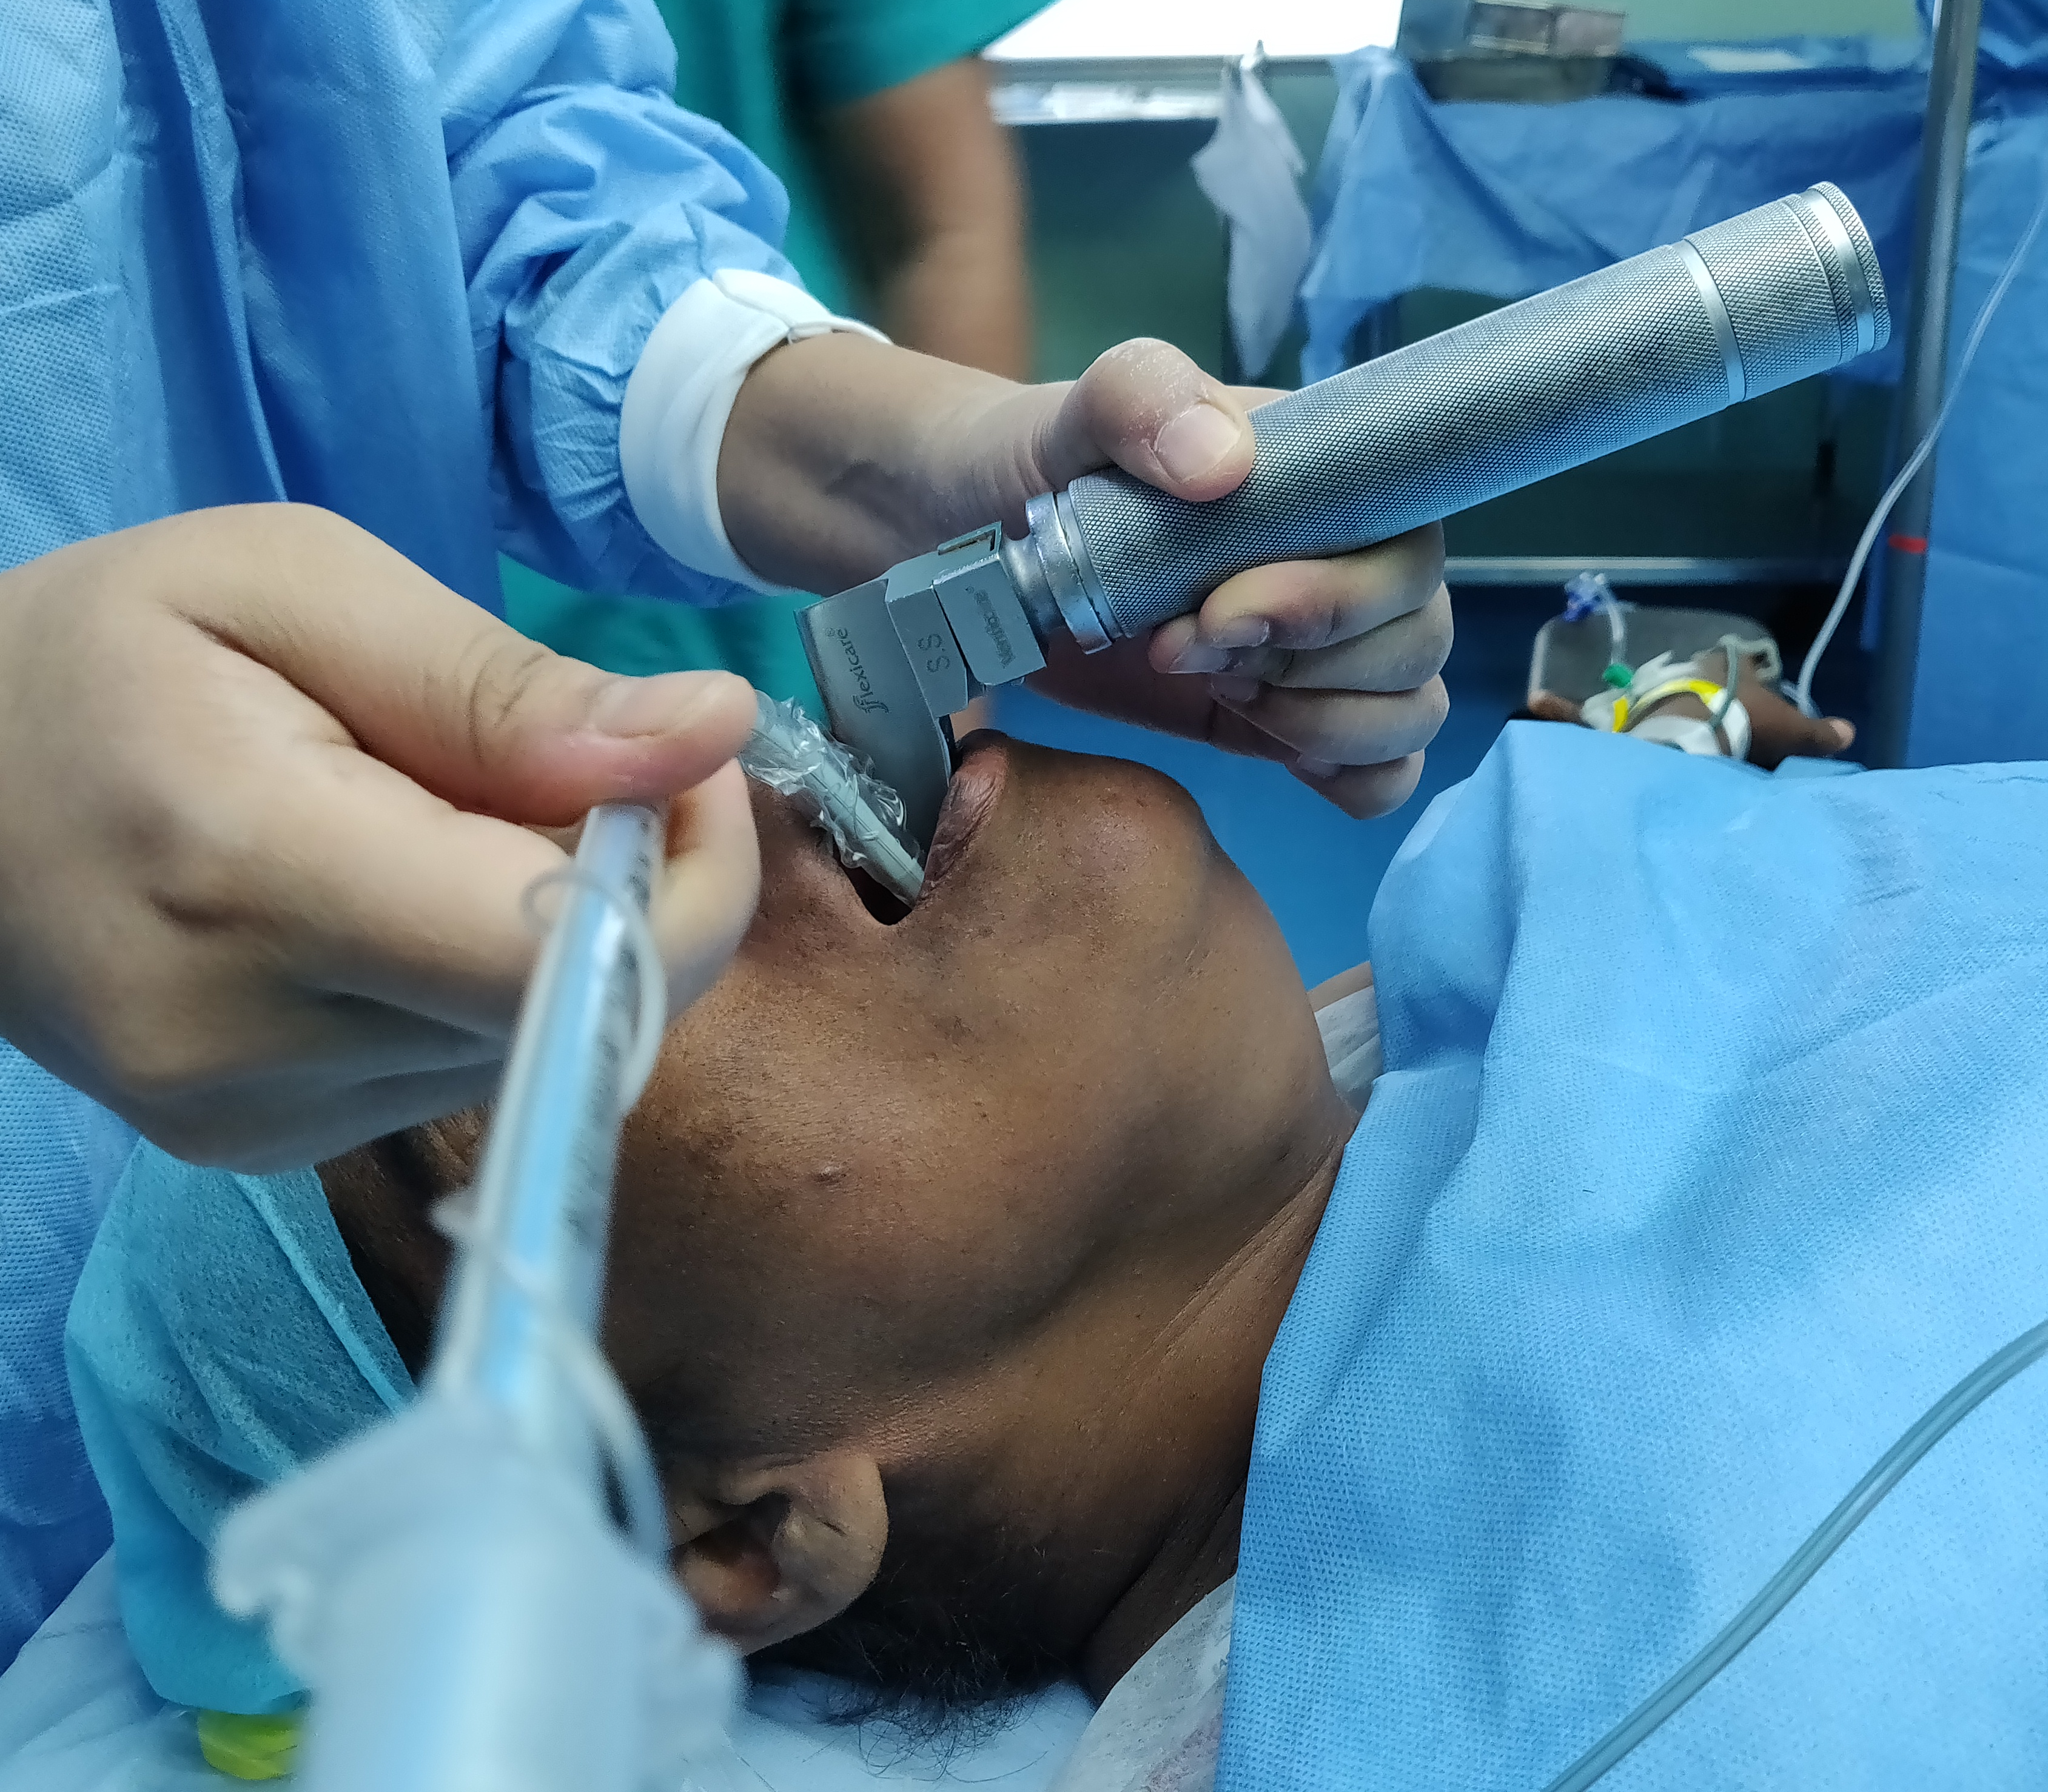
Intraoperative
Greater fall in Heart rate and Blood pressure during induction
Induction
Ensure patient is euvolemic
Use titrated doses of induction agent
Keep vasopressors ready
Risk of aspiration
Consider RSI
Less increase in HR and BP with intubation
Intubation
Notes:
Loss of compensatory vasoconstriction and tachycardia due to the vasodilatory effects of anesthetics

Slide 18
Intraoperative
Maintenance
Intraop cardiovascular instability
Position
IPPV
Volatile anesthetics
Blood loss
Pneumoperitoneum
Hypocapnia
Change position slowly
Titrate volatile anesthetics
Replace volume loss
Slow insufflation for PP
Keep vasopressors ready
ECG monitoring (ischemia)
Low threshold for invasive monitoring (IBP, CVP)
Unpredictable response to vasoactive medications

Slide 19
Intraoperative
Maintenance
Monitor temperature
Use warming devices
Hypothermia
Difficult to assess depth of anesthesia
Use DoA monitors
Strict aseptic technique
Padding of pressure points
Careful positioning to avoid fractures
Prone to infections and injury

Slide 20
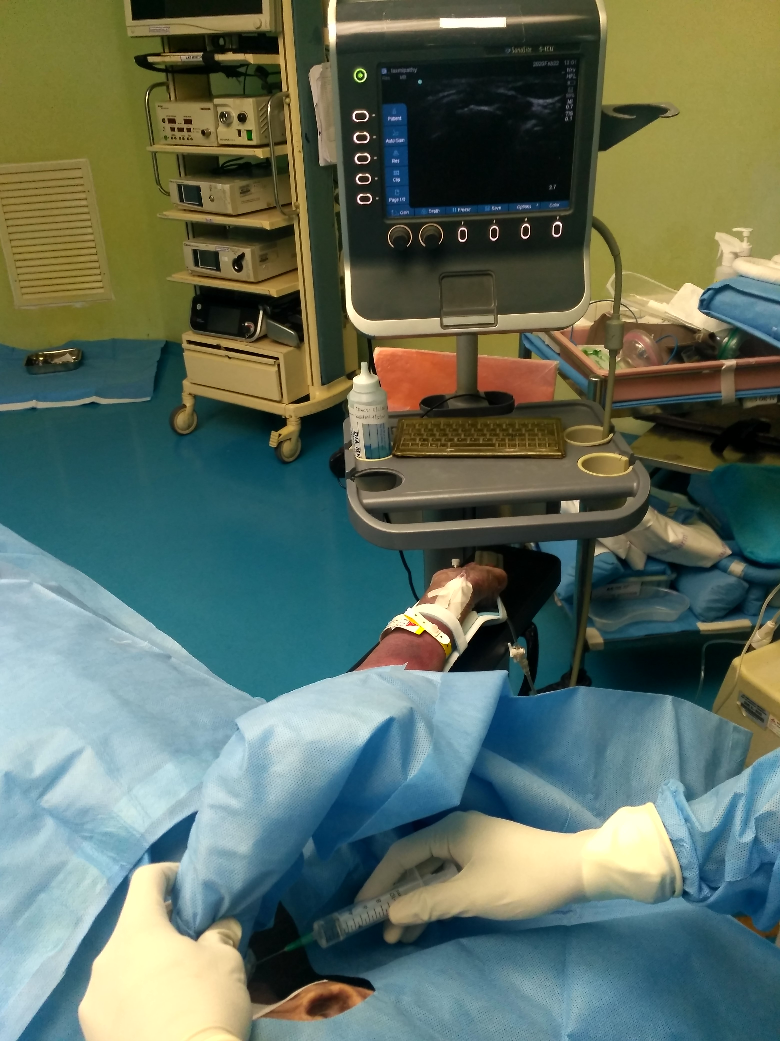
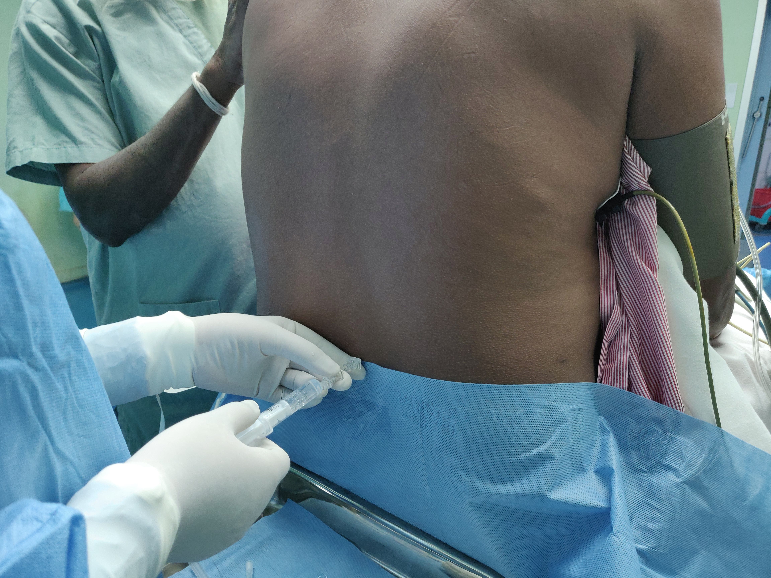
Intraoperative
Regional Anesthesia
Hypotension with central neuraxial block
Neuropathy with peripheral nerve block

Slide 21
Postoperative
Monitoring
Analgesia
Oxygen, hydration, temperature

Slide 22
Take home points
Autonomic neuropathy a common complication of diabetes mellitus
Parasympathetic system is affected early, later sympathetic system is also affected
Assessment is based on symptoms, signs and specific tests
Several anesthetic implications – especially hemodynamic instability, aspiration risk, hypothermia

Slide 23
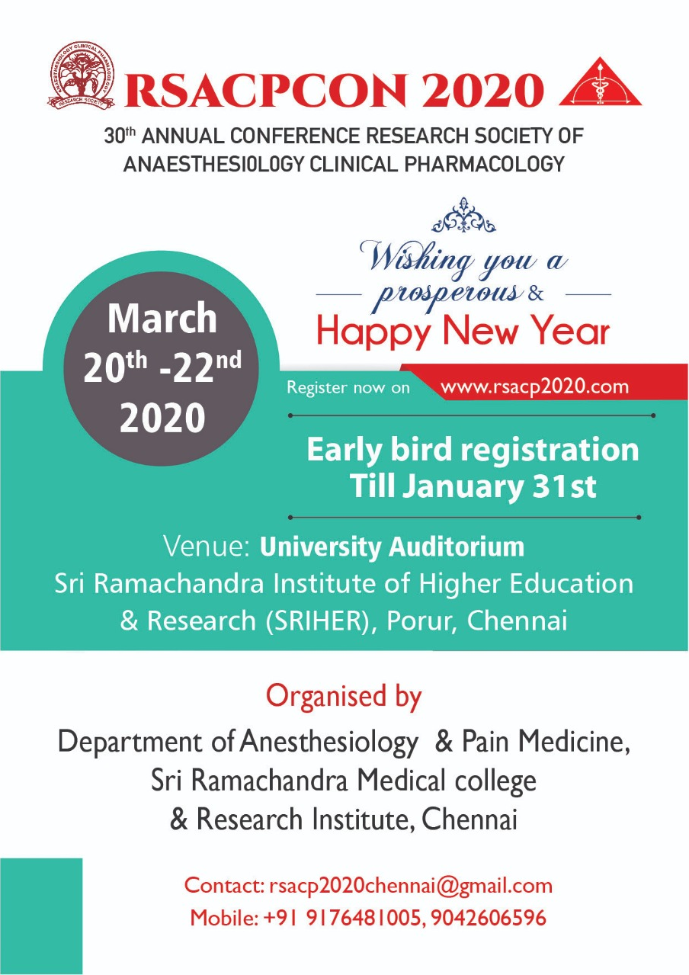
Thank you
Early-Bird extended till
February 29th
72 lectures, 6 workshops
13 awards
Register @ Rs 6000
PGs – Rs 5000

